Slide 1

  lesson 16
  Database Management Systems and Enterprise Software

Slide 2
This lesson includes the following sections:
    Databases and Management Systems
    Working with a Database
    Enterprise Software

Slide 3
Databases and Database Management
Systems
The Difference between Databases and DBMSes
Database Basics
DBMSes Basics

Slide 4
Databases and Database Management Systems
The Difference between Databases and DBMSes
A database is a repository for collections of related data or facts.
A database management system (DBMS) is a software tool that lets users add, view, and work with the data in a database.
Large databases and DBMS’ are commonly used by companies, but many productivity applications are built around database concepts.

Slide 5
Databases and DBMSes - Database Basics
Databases use three main structures for organizing data:
Fields, which store various pieces of data related to a single entity.
Records, or collections of fields relating to an entity.
Tables, which are collections of related records.
The two primary types of databases are flat-file databases (with only one table) and relational databases (with multiple, related tables).

Slide 6
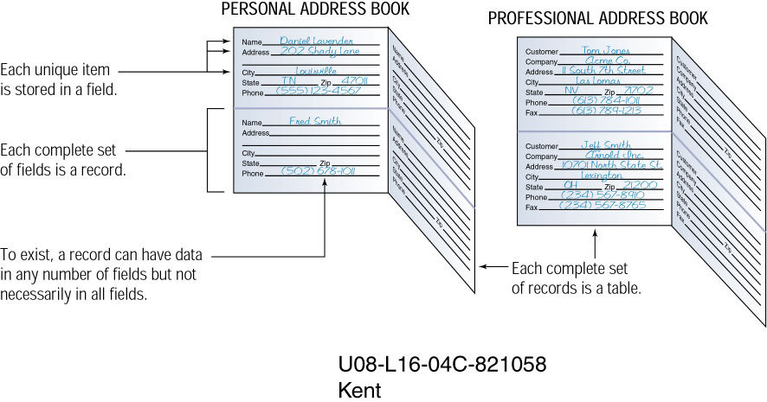
Field
Record

Slide 7
PROFESSIONAL ADDRESS BOOK
Table

Slide 8
Databases and DBMSes - DBMS Basics
A DBMS allows users to access and manage the data collected in a database.
Data management tasks (all done through the DBMS) can be divided into three categories:
Entering data into the database.
Sorting (rearranging) the data in the database.
Obtaining subsets of the data for use.

Slide 9
Working With a Database
Creating Database Tables
Viewing Records
Sorting Records
Querying a Database
Generating Reports

Slide 10
Working With a Database –
Creating Database Tables
The first step in building a database is to create its tables. This means identifying, naming, and organizing its fields to receive data.
Databases can store the following types of fields:
Text Logical Numeric Date/Time
Memo Binary Counter

Slide 11
Working With a Database –
Creating Database Tables
You can create forms that let you view and enter data for one record at a time.
Database tools such as masks can validate data as it is entered and thus ensure the data is in the correct format.

Slide 12
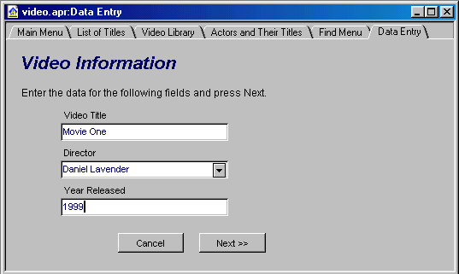

Slide 13
Working With a Database - Viewing Records
A filter is a tool that lets you view records that match a given criteria.
Filters are helpful when searching for certain types of information in a large database with many records.
A form can work with a filter, but enables you to view information about a single record.

Slide 14
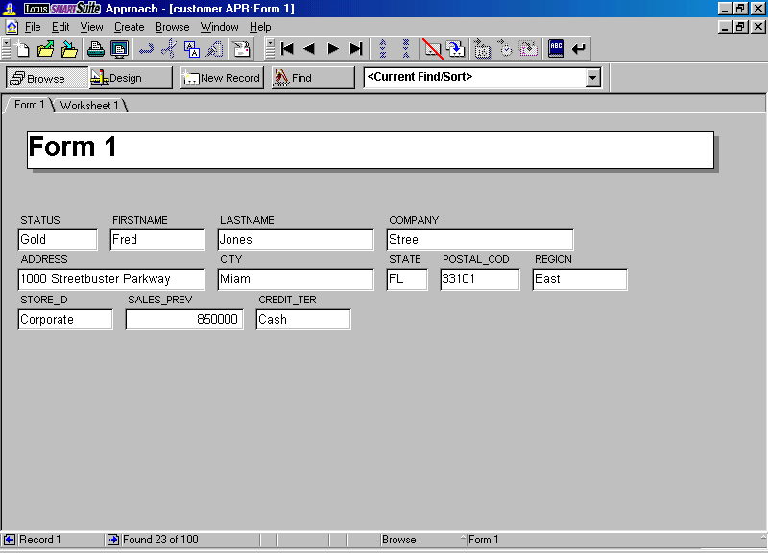

Slide 15
Working With a Database - Sorting Records
Sorting means arranging the records in a database.
A DBMS enables you to sort records alphabetically, numerically, and chronologically.
You can sort records in ascending (A-Z) order or descending (Z-A) order.

Slide 16
Working With a Database -
Querying a Database
A query is a statement you define, which tells the DBMS to find records that match criteria you specify.
Modern DMBS software provides built-in querying tools, based on one or more of the following languages:
SQL
Query by Example (QBE)
Xbase

Slide 17
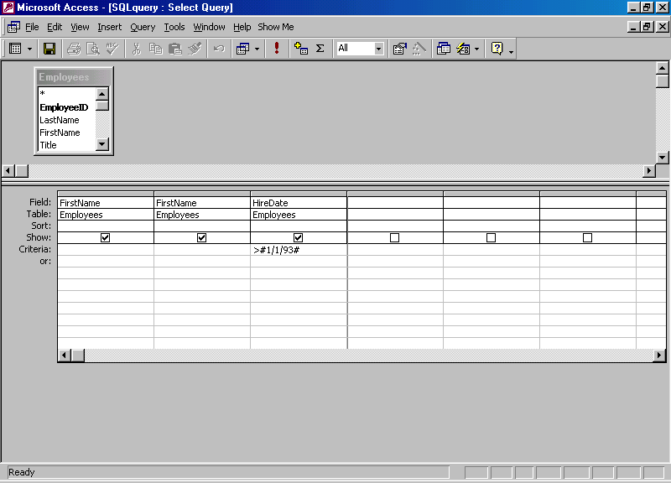

Slide 18
Working With a Database -
Generating Reports
A report is a subset of information from a database, produced in printed form.
You can generate the data for a report by using a query, filter, or other tools.
Reports can be formatted in a wide variety of ways.

Slide 19
Enterprise Software
Enterprise software is a large-scale application based on a DBMS, used by a large organization.
Enterprise software can meet the needs of many different users in different locations.
In an enterprise, different users by have different interfaces to the database, so they can work only with the data they need.

Slide 20
lesson 16 review
Define the terms database and database management system (DBMS).
List three tasks that a DBMS enables users to do.
Differentiate between flat-file databases and relational databases.
List three steps needed to create a database.
Explain the purpose of filters and forms.
List three examples of query languages.

